Slide 1

Selected Topics in Python Using Matplotlib
Notes:
‹#›

Slide 2

Objectives
Objectives
Discover how to use Matplotlib?
Explore the different types of plots
Notes:
‹#›

Slide 3
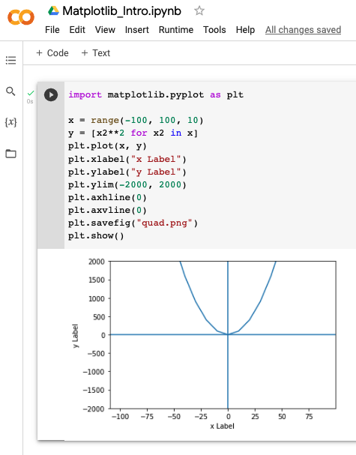
Matplotlib
What is Matplotlib?
Notes:
Matplotlib is a comprehensive library for creating static, animated, and interactive visualizations in Python. Matplotlib makes easy things easy and things are are hard possible to visualize.
‹#›

Slide 4
Line Plot
Line plots
Used to show trends.
Compare multiple values.
Changes of values over time.
Numerical data.
Make predictions.
Notes:
‹#›

Slide 5
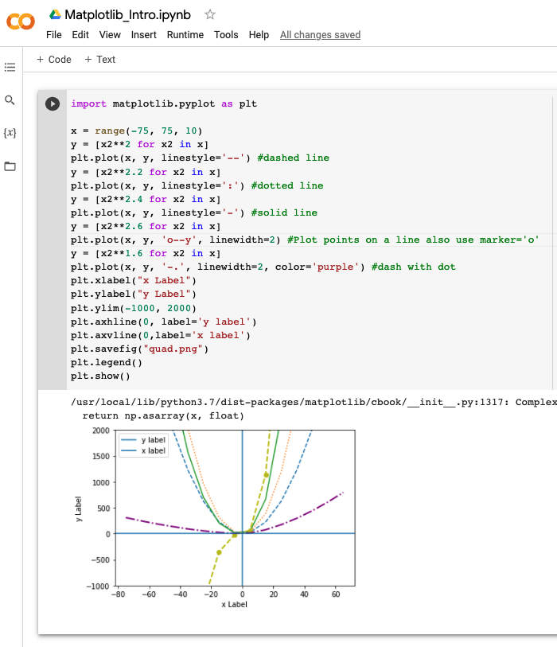
Line Plot
Line plots
linestyles
linewidth
color
legend
Notes:
‹#›

Slide 6
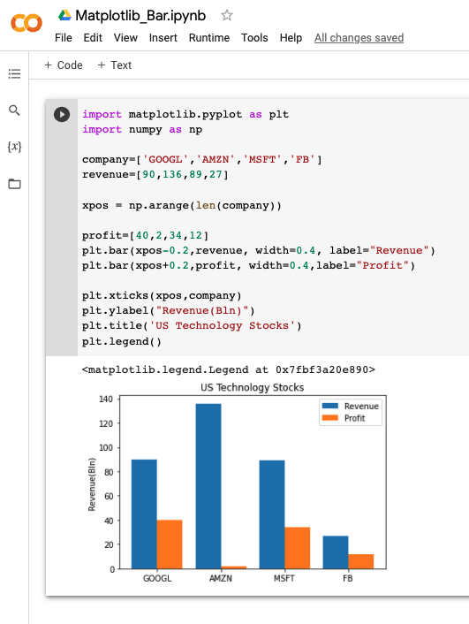
Bar Plot
Bar plots
Normal and/or ordinal categories.
Compare data against different categories.
Use when greater than 3.
Compare large data sets over time.
Notes:
‹#›

Slide 7
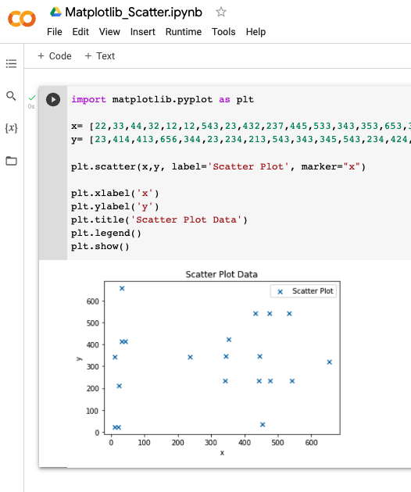
Scatter Plot
Scatter plots
Visualize the relationship between multiple numerical values.
Visualize the correlation in a large data set.
Predict behavior based on the measurement of the independent variable.
Notes:
‹#›

Slide 8
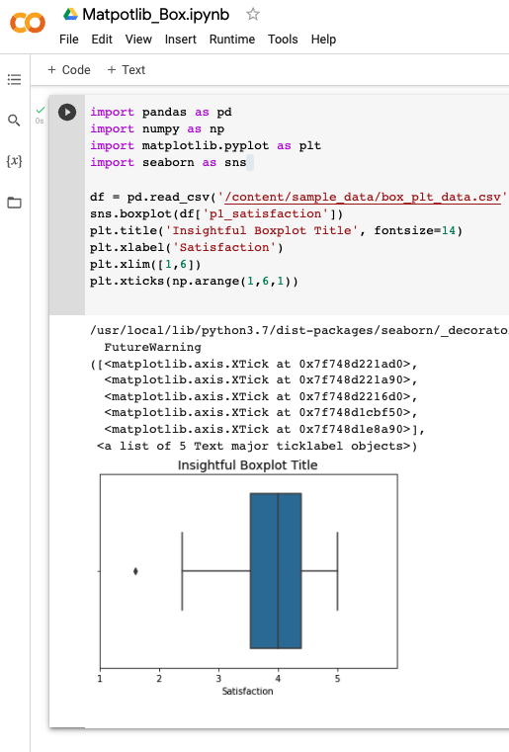
Box Plot
Box plots
Show whisker plots.
Displays statistical graph for sets of numerical data.
Shows the range, spread and center.
Used to compare data from different categories.
Notes:
‹#›

Slide 9
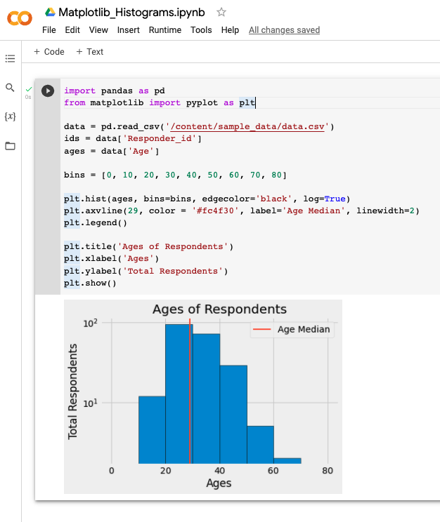
Histograms
Histograms
Used for continuous data.
Displays the frequency distribution.
Summarizes large data sets graphically.
Compare multiple distributions.
Notes:
Hope this gives you a basic understanding of how MatPlotlib can transform your data into a more visual display of data. See you in the next video.
‹#›

